Slide 1
Rail App

Slide 2

Network Rail

Slide 3
Network Rail Work
Groundworks
Track Side
Off Track
Track side
Tunnels
Stations
Electrification

Slide 4





Groundworks
Groundworks

Slide 5

Track Side
Track Side

Slide 6
Off Track

Slide 7



Network Rail Tunnels
Tunnels

Slide 8
Stations
Stations

Slide 9
Electrification
Electrification

Slide 10

London Underground

Slide 11

GPS Signal

Slide 12
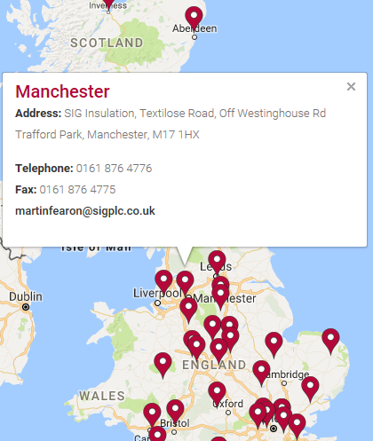
Store Location

